Slide 1

Interactive 3D Experience
Lesson 15:
Navigation in Unity
Elyas Chua-Aziz
cel9@np.edu.sg
Diploma in IMGD
October 2020

Slide 2
NavMesh
NavMesh is short for Navigation Mesh.
It is a feature in Unity that allows us to quickly build navigation capabilities for our applications.
Building a NavMesh will create points in our game world where NPCs can navigate to.
We can also use this to move a player to certain positions without any player input.
To allow NPCs or players to navigate on a NavMesh, we need to add a NavMeshAgent component to them.
We will first take a look at how we can build a NavMesh.

Slide 3
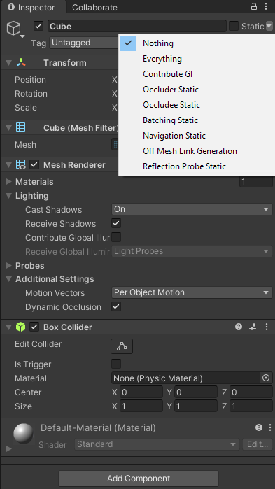
NavMesh
The process of creating a NavMesh is known as NavMesh Baking.
To bake our NavMesh, we first have to mark objects as Navigation Static in Unity.
If an object is marked as Navigation Static, it means that it will not affect how navigation is calculated on the fly.
Only Navigation Static objects will be calculated when baking a NavMesh.
You can mark objects as Navigation Static from the Inspector.
Click on the arrow beside ‘Static’ and choose Navigation Static.

Slide 4
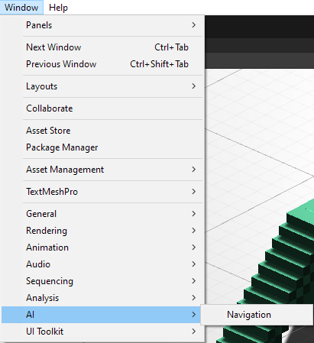
NavMesh
Once you have your environment or structures marked as Navigation Static, you can begin baking the NavMesh.
Access the Navigation window from Window > AI > Navigation.
A Navigation Window will pop up, usually in the same window as your Inspector.

Slide 5
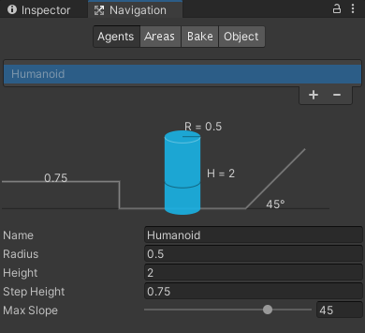
NavMesh
There will be 4 tabs available in the Navigation Window
Agents
Areas
Bake
Object
We will focus on the Bake tab for now.

Slide 6
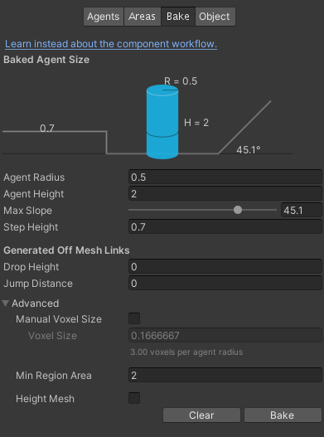
NavMesh
There are a number of variables that we can modify here:
Agent Radius
How close the center of a NavMeshAgent can get to a wall
Agent Height
How low spaces can be before they are inaccessible to a NavMeshAgent
Max Slope
The maximum angle of a slope that a NavMeshAgent can walk up
Step Height
How high obstructions can be for a NavMeshAgent to step on

Slide 7
NavMesh
There are a number of variables that we can modify here:
Drop Height
The height that a NavMeshAgent can drop down from
Jump Distance
The distance between two NavMesh areas that a NavMeshAgent can jump across
Once you have set your values, click on the “Bake” button.
Based on your values here, Unity will study the provided environment and build an appropriate NavMesh.

Slide 8
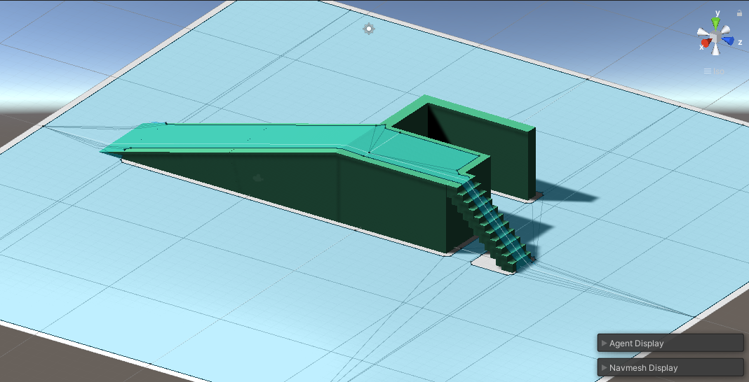
NavMesh
How a baked NavMesh looks like. The blue areas define the walkable spaces for NavMeshAgents.

Slide 9
Demo Time!

Slide 10
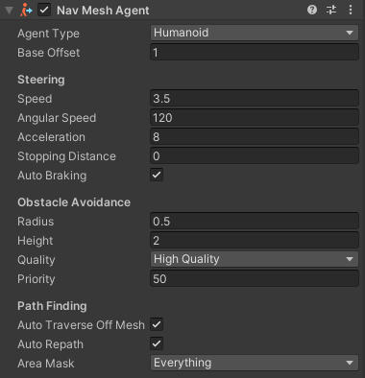
NavMeshAgent
The NavMeshAgent component allows its attached GameObject to navigate the scene using the baked NavMesh.
The variables we can modify here are:
Agent Type
The base Agent settings as defined in the Navigation window.
Changing your selection here will change the values in the “Obstacle Avoidance” section.
Base Offset
The vertical offset of the NavMeshAgent and the attached GameObject.
The center of the GameObject will typically be in the center of its 3D representation, while the center of the NavMeshAgent is at its base.
This lets the NavMeshAgent know the offset to use in its calculations.

Slide 11
NavMeshAgent
The variables we can modify here are:
Speed
The maximum forward speed of the NavMeshAgent
Angular Speed
The maximum turning speed of the NavMeshAgent
Acceleration
The maximum acceleration of the NavMeshAgent as it follows a path.
Stopping Distance
The distance at which the NavMeshAgent will stop away from its target.
Auto Braking
Controls whether the NavMeshAgent will stop in time before it overshoots its target.

Slide 12
NavMeshAgent
The variables we can modify here are:
Radius
The width of the NavMeshAgent
Height
The height of the NavMeshAgent
Quality
Affects how often NavMeshAgents might overlap.
Lower quality means more often overlaps, but less computing stress.
Priority
A NavMeshAgent will ignore other agents that have a value.
A lower value here means higher priority, as it will ignore more things.

Slide 13
NavMeshAgent
With a NavMeshAgent attached to our object, we will want to give it a target destination to move toward.
We can do this through code by using the NavMeshAgent.SetDestination() function.
The function takes in a Vector3 variable, so we need to pass in the position where we want our agent to navigate towards.
The function will return a bool value.
If it succeeds in finding a path to the target, it will return true. If it does not, it will return false.
One common implementation is to have our agent constantly move towards a Transform.
Let’s take a look at how we can implement that.

Slide 14
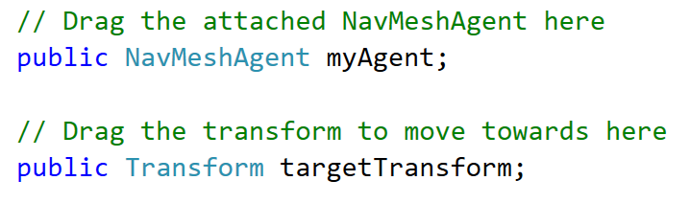
NavMeshAgent
First, we have to create variables to hold the attached NavMeshAgent component, as well as the Transform that we want our agent to chase.

Slide 15
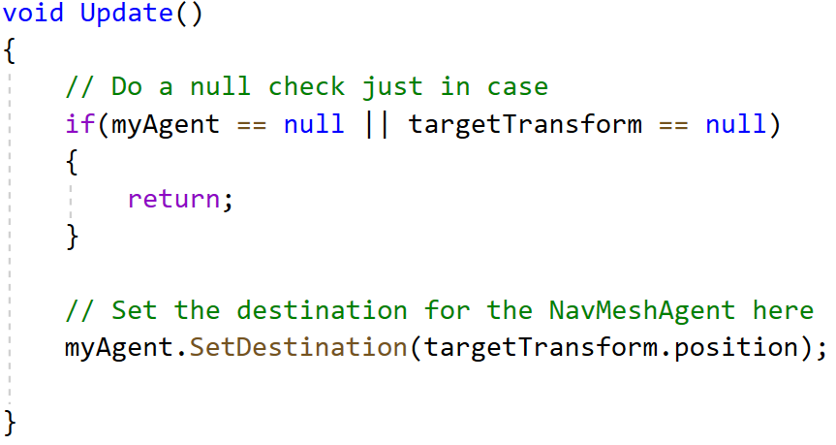
NavMeshAgent
Then, we will set the destination of the agent constantly in Update() so that it continues chasing the target.
Alternatively, you can choose to only use SetDestination when a specific event happens
E.g. when a player triggers an alarm and guards go to the last known location of the player.
This can be useful for stealth games

Slide 16
Demo Time!

Slide 17
Navigation Area
Now that we have a NavMesh and a NavMeshAgent, we can use Navigation Areas to modify the behaviour of our agents.
Navigation Areas will have a movement cost attributed to them.
Agents will typically avoid areas that have a higher movement cost.
We can also assign which areas are unwalkable for certain agents.
We can use this to change how our agents move, as well as give our players some mechanics they can play with.
E.g. A player could have some equipment to move over water, while normal enemies are unable to.

Slide 18
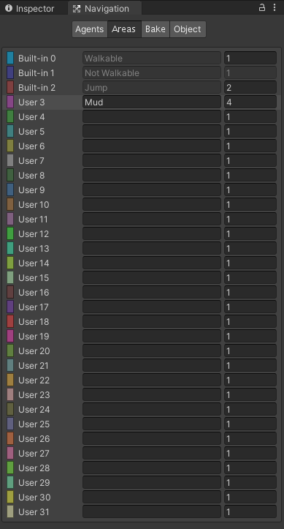
Navigation Area
To set up our Navigation Areas, we have to go to the “Areas” tab in the Navigation Window.
There are already a few default areas created by Unity.
The first field represents the name of the area, and the number represents the movement cost of the area.
The ‘Mud’ area has a high movement cost of 4, which will cause agents to avoid moving through it if possible.
After setting up our areas here, we can go back to the Scene view to add our custom areas.

Slide 19
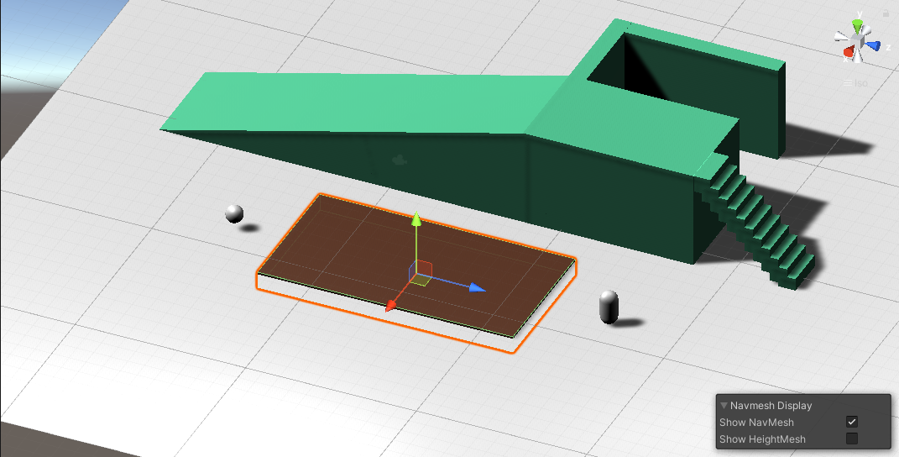
Navigation Area
Create a 3D object to represent your Navigation Area.
Place it where you want your area to be.

Slide 20
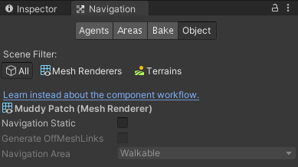
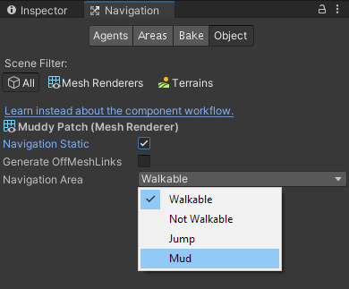
Navigation Area
With the object selected, click on the “Object” tab in the Navigation window.
Check the Navigation Static box, and set the Navigation to be your custom area.
Go back to the “Bake” tab, and press the “Bake” button again.

Slide 21
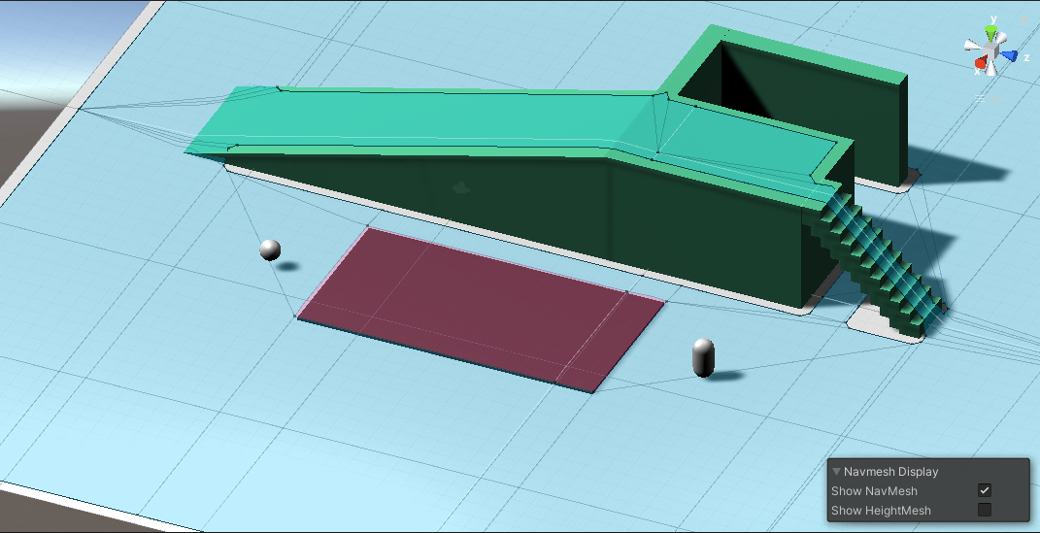
Navigation Area
The NavMesh will now recognize the 3D object as a different area, and will mark it out as such.
How will this affect the movement of the agent?

Slide 22
Demo Time!

Slide 23
Summary
By baking a NavMesh, we add navigation points into our world that NavMeshAgents can use to calculate paths to move on.
Using different Navigation Areas will add some variety to the behaviour of agents.
While being relatively simple to use, the Navigation system in Unity is a powerful tool we can use as a base for complex mechanics and gameplay.

